Slide 1

Even More on Hypothesis Testing
CEE 465/CEWA 565 Fall 2019
Lecture 4 (continued from Lecture 3)

Slide 2
Class Project: Only for Grads
Undergrads, write “I am an undergrad” on that homework problem.
Topic and Partner this week.
Update will be due on Oct 31st – for this assignment, you will need to provide plots of your data and clear questions of exactly what you will test with the data
This is 25% of your grade, so the work required is substantially more than a homework assignment, so I don’t want you to redo a homework assignment with new data.
I want you to demonstrate an ability to apply the tools we’ve been using in an intelligent way and to clearly communicate how and why you’re using these tools and what they tell you about the data (as well as what they don’t). You will need to be able to write a 10-page report (which includes graphs).
Look at some of the papers on the canvas site to see how the tools we are learning are used for real science.

Slide 3
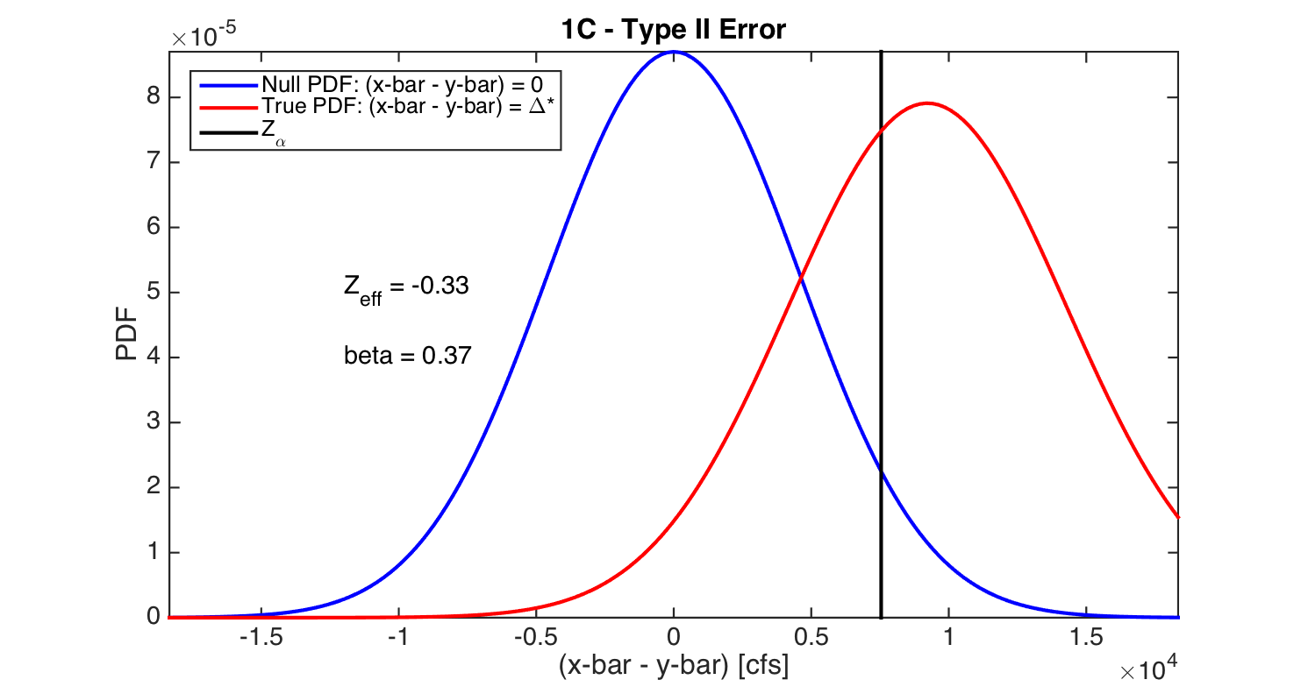
Type two Error: One-sided vs. Two-sided
So far we did a one-sided test.
Power = 63%
For those who like R:
http://www.r-tutor.com/elementary-statistics/type-2-errors/type-2-errors-two-tailed-test-population-mean-unknown-variance

Slide 4
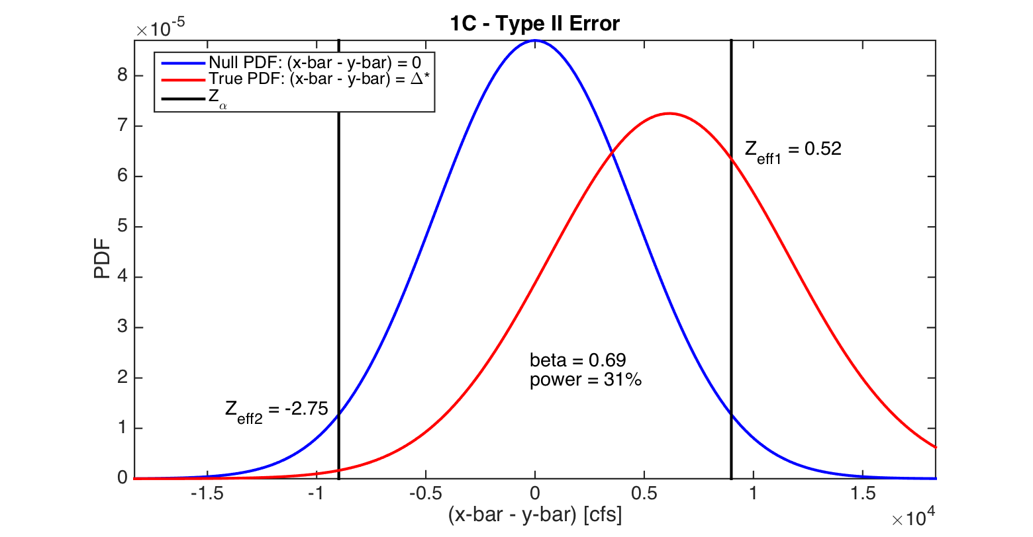
For two-sided, note that you need the area in between the two black lines: Note that 69% of the area under the red curve falls within the “do not reject the null” region.
Note: small chance that mean could fall out here and be rejected
That’s P<=zeff1 – P<=zeff2
So we need the area of under the red curve falling between the black lines
Power = 30%

Slide 5
One-sided vs. two-sided tests
What is the p-value?

Slide 6
One-sided test
What is the p-value?
The p-value is the smallest significance level α that would lead us to reject the null hypothesis
α=0.05
α=0.01
z
-1.6
0
1.6
2.3

Slide 7
One-sided test
What is the p-value?
The p-value is the smallest significance level α that would lead us to reject the null hypothesis
My test statistic
α=0.05
α=0.01
z
-1.6
0
1.6
2.3
1.92

Slide 8
One-sided test
What is the p-value?
The p-value is the smallest significance level α that would lead us to reject the null hypothesis
My test statistic, α=0.027
My test gives a value that would require me to reject the null hypothesis at α=0.5 but accept it at α=0.1. At what α specifically does this change take place? That’s the p-value.
As drawn, p-value = _____
α=0.05
α=0.01
z
-1.6
0
1.6
2.3
1.92
Notes:
https://onlinecourses.science.psu.edu/stat414/node/267

Slide 9
Same data: Two-sided test
What is the p-value?
The p-value is the smallest significance level α that would lead us to reject the null hypothesis
α=0.05
My test statistic
Cut-off lines drawn at α/2
z
-1.6
0
1.6
1.96
1.92
Now we don’t reject the null! What is the p-value?
Notes:
https://onlinecourses.science.psu.edu/stat414/node/267

Slide 10
Same data: Two-sided test
What is the p-value?
The p-value is the smallest significance level α that would lead us to reject the null hypothesis
α=0.05
My test statistic, α/2=0.027
What is the p-value?
What choice of α would give us α/2=0.027?
0.027*2 = 0.055
Cut-off lines drawn at α/2
z
-1.6
0
1.6
1.96
1.92
This is where the multiply by 2 comes from
Notes:
https://onlinecourses.science.psu.edu/stat414/node/267

Slide 11
Small Sample Tests Using the T Distribution

Slide 12
Applications
The T distribution may be used if the sample sizes are smaller than about 30 , however the two populations must be normally distributed (or at least reasonably close to normally distributed).
The T statistic is selected based on the Type I error (α) and the number of degrees of freedom, which is determined by the sample size.
Table of values:
See stats_tables.PDF in the files folder for Week 2 on Canvas.
http://www.sjsu.edu/faculty/gerstman/StatPrimer/t-table.pdf

Slide 13
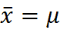
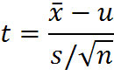
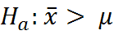
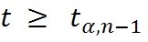
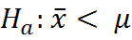
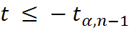
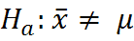
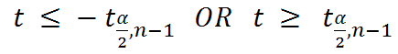
Single Sample Test:
Null Hypothesis:
α = Probability of a Type I error, number of degrees of freedom = (n-1)
Test statistic:
Alternate Hypothesis: Rejection Region:
u = μ here

Slide 14
Single Sample Test Example:
Null Hypothesis: True mean is 0. We have a sample of 10 numbers, with a sample mean of 2 and sample standard deviation of 1. They seem close to normally distributed.
Quick question: Based on our homework, can we tell if 10 numbers are normally distributed?
α = Probability of a Type I error (we set this at 5%), number of degrees of freedom = (n-1)
Test statistic:
Alternate Hypothesis: Rejection Region:
u = μ here
t = 2/(1/sqrt(10)) = 6.32
And what if the sample standard deviation were 2?
t = 3.16 (use stats_tables.PDF)

Slide 15
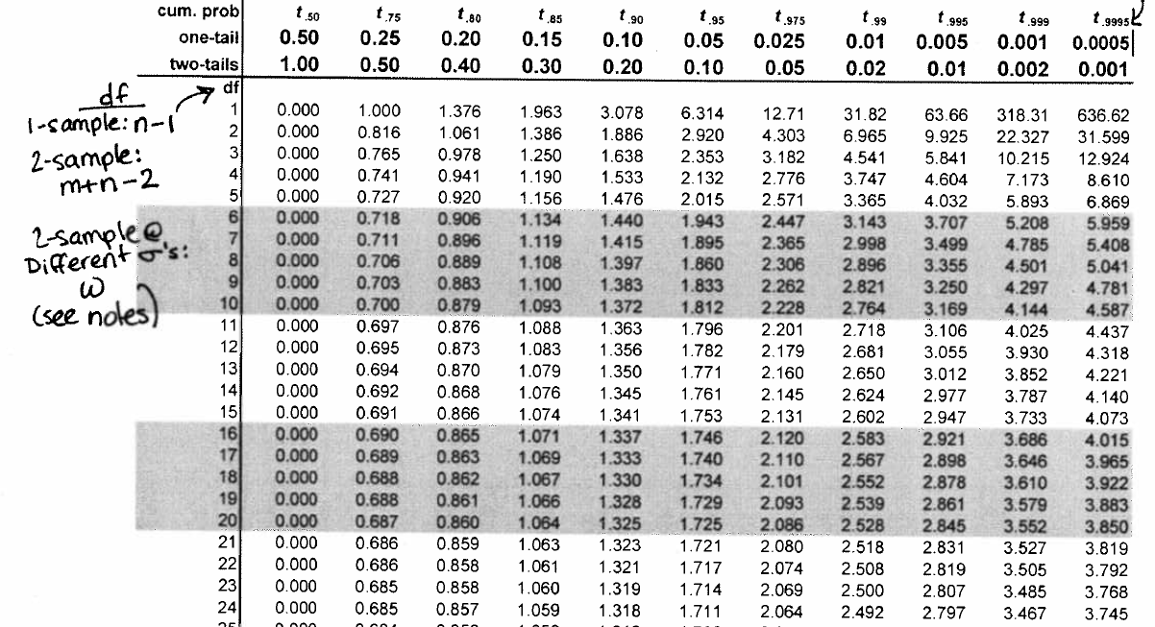
6.32 is larger than 1.833. Do we reject the null?
From stats_tables.PDF
Notes:
Yes!

Slide 16
Python code for t-statistic
Can find various packages online to lookup the t-statistic in python:
https://towardsdatascience.com/inferential-statistics-series-t-test-using-numpy-2718f8f9bf2f
https://docs.scipy.org/doc/scipy/reference/generated/scipy.stats.ttest_ind.html

Slide 17
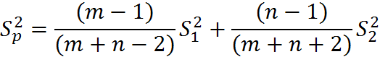
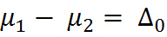
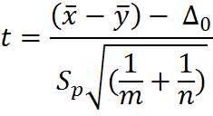
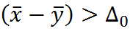
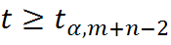
Two Sample T tests:
Pooled estimator of S:
Null Hypothesis:
Test Statistic:
Alternate Hypothesis: Rejection Region:
Ha:
Here we are assuming that the true variance of the two populations is the same.

Slide 18
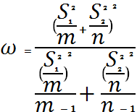
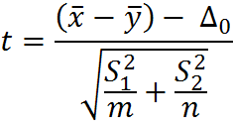
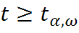
Two Sample T tests for Different Standard Deviations and Sample Sizes.
Number of Degrees of Freedom:
Null Hypothesis:
Test Statistic:
Alternate Hypothesis: Rejection Region:
Ha:

Slide 19
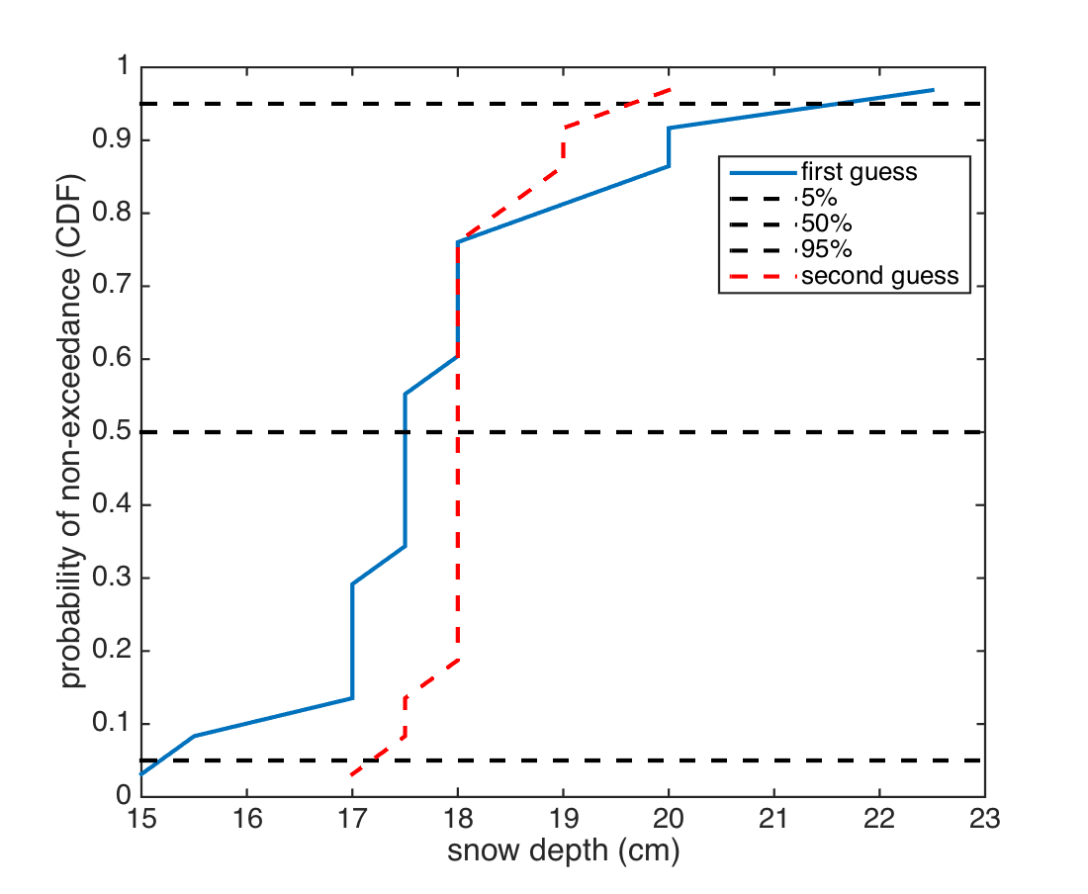
This is the one I want for my snow-pole test for 2016 with 2 guesses!
Null:
0
Alternative:
0
Second guess
First guess

Slide 20
y
x
 | first guess | second guess
 | 17 | 17
 | 18 | 18
 | 18 | 18
 | 15 | 18
 | 18 | 18
 | 22.5 | 20
 | 17 | 19
 | 17.5 | 18
 | 15.5 | 17.5
 | 19 | 18
 | 18 | 18
 | 17.5 | 17.5
 | 17.5 | 18
 | 20 | 18
 | 17.5 | 18
 | 17 | 18.5
 | 17 | 19
 | 20 | 18
 | 17.5 | 18
Mean | 17.9 | 18.1
Mode | 17.5 | 18.0
Median | 17.5 | 18.0
Standard Deviation | 1.7 | 0.6
m = n = 19
I get 22.4
=0.2 / 0.4
= 0.5

Slide 21
0.5 is not larger than 1.7. Do not reject the null.
From stats_tables.PDF

Slide 22
Inferences Regarding the Standard Deviation

Slide 23
Does the central limit theorem apply to the standard Deviation?

Slide 24
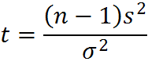
Inferences Regarding the Standard Deviation:
The central limit theorem does not apply to random samples of the variance from a population; however, assuming an underlying normal distribution, we can test some hypotheses regarding the variance of a sample:
Single sample test from a population with “known” standard deviation:
Let X1, X2, . . . ,Xn be a random sample from a normal distribution with parameters μ and σ
Then the test statistic:
Is Chi Squared distributed with n-1 degrees of freedom.
Tables (see 2nd page of stats_tables.PDF on canvas, or):
http://www.itl.nist.gov/div898/handbook/eda/section3/eda3674.htm
http://www.stat.tamu.edu/~west/applets/chisqdemo.html

Slide 25
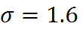
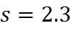
Using this approach we can broadly test the hypothesis that an arbitrary sample variance is from the population with assumed known variance.
Example:
Suppose we have a long record of temperature at a station from which we estimate:
A shorter period of 20 years at the end of the record has a sample standard deviation:
Does this sample statistic suggest a statistically significant change in the standard deviation at this station location?

Slide 26
Using this approach we can broadly test the hypothesis that an arbitrary sample variance is from the population with assumed known variance.
Example:
Suppose we have a long record of temperature at a station from which we estimate:
A shorter period of 20 years at the end of the record has a sample standard deviation:
Does this sample statistic suggest a statistically significant change in the standard deviation at this station location?
=39.26 -- we have n-1, or 19 degrees of freedom and want 95% confidence if we reject

Slide 27
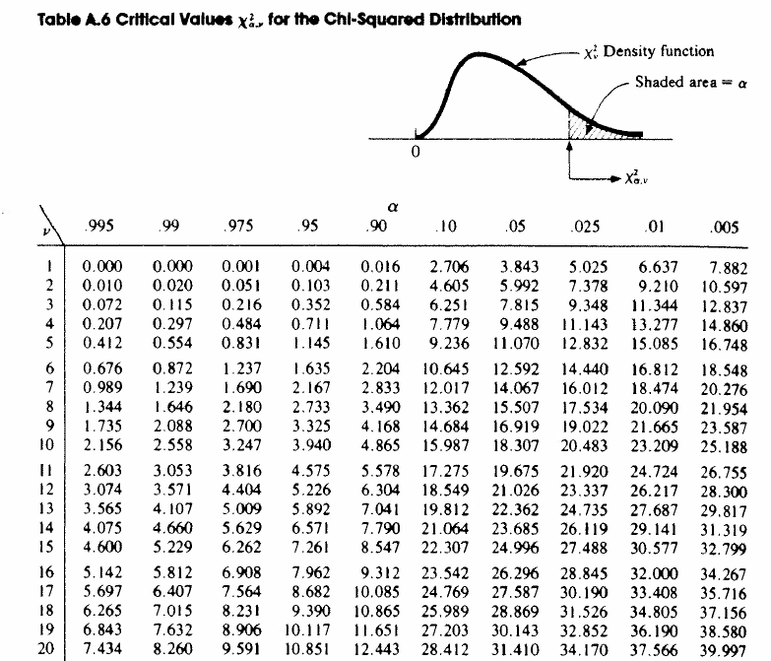

Slide 28
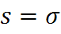
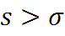
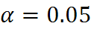
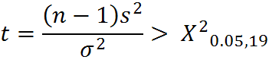
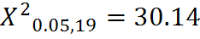
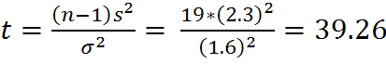
Null hypothesis:
Alternate hypothesis:
Confidence level :
Rejection region:
Where,
So, yes, the statistics from this sample suggests a statistically significant change in the standard deviation at this station.

Slide 29
Non-Parametric Tests for Change in the Mean

Slide 30
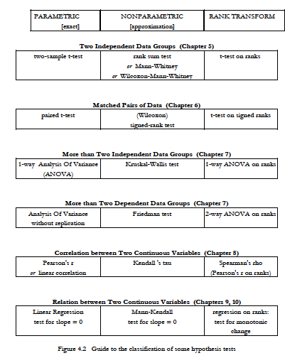
Note:
P 105 Hershel and Hirsch has a nice summary of all the different tests available
– we only have time to cover some of them

Slide 31
When should you choose a parametric test vs. a non-parametric test?

Slide 32
When should you choose a parametric test vs. a non-parametric test?
Parametric: Use when you’re confident your data are normally distributed
Non-Parametric: Use when the data are not normally distributed
Question: What if I just can’t tell either way? It’s okay to run both tests. If they give you the same result, you feel better. If not, then you need to think about about it some more…

Slide 33
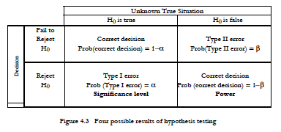
What’s the penalty for picking the wrong test (other than having reviewers and stats experts look down on you)?
Improperly using a Parametric test will tend to increase your Type II error.
P 107 Hershel and Hirsch

Slide 34
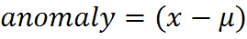
Sign Test:
Let:
If the sample mean is equal to an assumed null hypothesis population mean, then we would expect the positive and negative anomalies from the sample to be about equal. With an increasing number of either positive or negative anomalies, it becomes increasingly less likely that the null hypothesis is true.

Slide 35
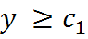
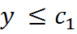
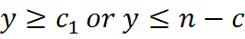
Sign Test for Small n
Null Hypothesis:
Test statistic:
Alternate Hypothesis: Rejection Region:
The critical values are extracted from the Binomial distribution Bin(n, 0.5) that corresponds to the level of alpha. (see stats_tables.PDF , page 3 for the Binomial tables)
Remember: For null to be true, about 50% should exceed the mean…

Slide 36
Example for n = 20
Notes:
This is the binomial distribution, binomial for tossing a coin, p=0.5, there’s a table for every sample size.

Slide 37
Wilcoxon Signed Rank Test:
For an assumed symmetric distribution shape, the Wilcoxon Signed Rank Test may be used. There is some loss of generality in comparison with the sign test (which assumes only continuity), but the performance is also better, closely approximating the performance of the T test for the normal distribution, and performing much better for more skewed or heavy-tailed distributions.
The basic idea is to calculate the anomalies (relative to the mean) for all the data points, and record their sign. Then rank the absolute value of the anomalies from lowest to highest. Finally sum the ranks of all the positive anomalies. In the case of ties, we assign each value in the tie the average rank
Example Data (see Excel File, Wilcoxan_rank_sum.xlsx): mean here is 13.

Slide 38
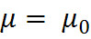
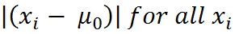
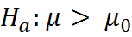
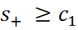
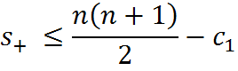
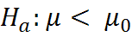
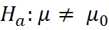
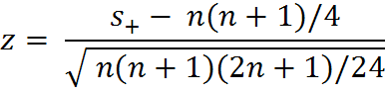
Single Sample Wilcoxon Signed Rank Test (see page 138-147 in Helsel and Hirsch):
Null Hypothesis:
Calculate and rank:
Test statistic:
Alternate Hypothesis: Rejection Region: (use c values in table A.9 in
stats_tables.PDF for small sample)
For n > 20 is normally distributed

Slide 39
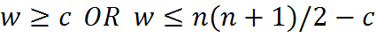
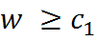
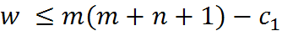
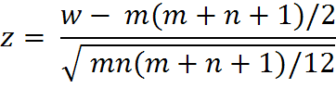
Two Sample Wilcoxon Rank-Sum Test (see excel file):
Let X and Y be two sample data sets with sample size m and n respectively. For small sample tests, let the smallest sample be labeled X.
Null Hypothesis: The median of two groups is the same, so
H₀: Prob[x > y] = 0.5
Calculate and rank: Rank all of the values in the combined sample, keeping track of which came from which group.
Test statistic:
Alternate Hypothesis: Rejection Region: (use Table A.10 for small sample)
H₁: Prob[x>y] ≠ 0.5 (2-sided test)
H₂: Prob[x>y] > 0.5 (1-sided, x expected larger than y)
H₃: Prob[x>y] < 0.5 (1-sided, x expected smaller than y)
For m,n > 10 is normally distributed

Slide 40
MonteCarlo Simulation

Slide 41
Inference Testing Using Monte Carlo Simulation:
Assuming a particular probability distribution, Monte Carlo Simulation can be used to construct an arbitrarily large set of M random samples (each with a finite sample size n).
For any test statistic (e.g. μ, σ) that can be calculated from these sample data sets, we can easily construct a set of empirical values defining a rejection region with Type I error α.
Procedure for independent (i.e. non-autocorrelated) data:
Create M random samples, each of sample size n.
Calculate the test statistic of interest for each sample.
Rank the M test statistics
Using the Cunnane unbiased quantile estimator, construct the CDF of the M sample test statistics.
Extract the appropriate quantile associated with the Type I error α. E.g. extract the 5th or 95th percentile from the CDF for α = 0.05 for a one-tailed test.
Compare the test statistic from another data set (with sample of size n), to this rejection value.

Slide 42
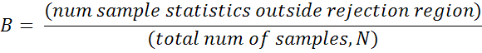
Monte Carlo Type II Error Analysis:
By constructing N samples of m values from a known probability distribution, we can also estimate the Type II error associated with our Monte Carlo inference test based on a given α from the previous page.
Procedure:
Construct a large random sample with a known change in μ and/or σ.
Calculate the test statistic of interest for each of these samples.
Count how many of these sample statistics are outside the rejection region for a given α and change in μ and/or σ using the Monte Carlo analysis from the previous page.
The fraction of the samples outside the rejection region, divided by the total samples is an estimate of Β. I.e.

Slide 43
The above is everything you need for homework 2. Please see the Week 2 labs for further examples and code.

Slide 44



ANOVA, Correlation, Linear Regression, Quantile Regression
Jessica Lundquist, CEE 465/CEWA 565
October 8 and 10, 2019

Slide 45
Analysis of Variance (ANOVA) (like what we just did but for more than two different samples)
See Chapter 7 in the Helsel and Hirsch textbook
Can also check out Brandon Foltz on Youtube: https://www.youtube.com/watch?v=0Vj2V2qRU10
Note: We will go over One Factor ANOVA. There are many variations of ANOVA.
Note 2: This is cookbook like. Don’t panic if you can’t remember how many teaspoons of salt go in a given recipe. Just remember where you put the recipe and when you want to use it. Also consider when it’s appropriate to use each test.

Slide 46
ANOVA (conceptually)
Like a sequence of t-tests, but multiple t-tests end up compounding the type I error (end up with a higher level of error than you set up with alpha)
Compares the overall variability among/between means of different groups with the internal spread within each group

Slide 47
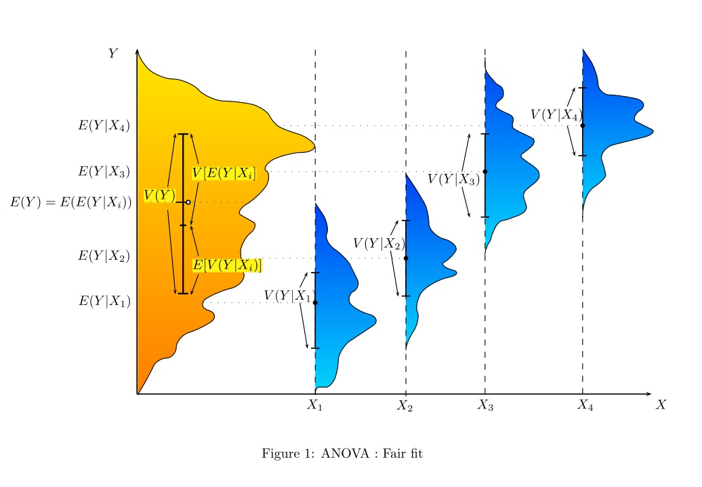
Illustration from: https://en.wikipedia.org/wiki/Analysis_of_variance

Slide 48

Illustration from: https://en.wikipedia.org/wiki/Analysis_of_variance

Slide 49

Illustration from: https://en.wikipedia.org/wiki/Analysis_of_variance

Slide 50

We think plants will grow to different heights with different fertilizer treatment.
But we need a falsifiable hypothesis. What might this be?
Graphic from https://onlinecourses.science.psu.edu/stat502/node/138

Slide 51

Null Hypothesis: All groups have the same central value (mean).
The test:
Compare the mean values of each group with overall mean for the entire data set.
Need to analyze the variance to tell if we can really tell the mean values apart
The F-ratio looks at the variance between groups divided by the variance within groups

Slide 52

How much variability is due to the different groups vs. something else (error/within group variability)
Where there are k different groups, with index j
And each group has n_{j} different samples, with index i

Slide 53

Key Assumptions for ANOVA
See page 166 Helsel and Hirsh

Slide 54



Data from 3 Fertilizer Treatments (also in lab)
Fertilizer Treatment #
j=1 j=2 j=3 j=4
i=1
i=2
i=6
Height of plant (cm)
N=24 (total number of observations)
K=4 (number of different groups)
ANOVA Table
See https://onlinecourses.science.psu.edu/stat502/node/137 for online lecture notes on ANOVA

Slide 55

Data from 3 Fertilizer Treatments (also in lab)
j=1 j=2 j=3 j=4
i=1
i=2
i=6
N=24
K=4
See https://onlinecourses.science.psu.edu/stat502/node/137 for online lecture notes on ANOVA

Slide 56
Data from 3 Fertilizer Treatments (also in lab)
j=1 j=2 j=3 j=4
i=1
i=2
i=6
N=24
K=4
Treatment
Error
Total
k-1=3
N-k=20
N-1=23
See https://onlinecourses.science.psu.edu/stat502/node/137 for online lecture notes on ANOVA

Slide 57

Data from 3 Fertilizer Treatments (also in lab)
j=1 j=2 j=3 j=4
i=1
i=2
i=6
Treatment
Error
Total
k-1=3
N-k=20
N-1=23
251.44
See https://onlinecourses.science.psu.edu/stat502/node/137 for online lecture notes on ANOVA

Slide 58

Data from 3 Fertilizer Treatments (also in lab)
j=1 j=2 j=3 j=4
i=1
i=2
i=6
Treatment
Error
Total
k-1=3
N-k=20
N-1=23
251.44
61.033
See https://onlinecourses.science.psu.edu/stat502/node/137 for online lecture notes on ANOVA

Slide 59

Data from 3 Fertilizer Treatments (also in lab)
j=1 j=2 j=3 j=4
i=1
i=2
i=6
Total SS =
Recall: If you calculate two SS, you can get the third easily.
Treatment
Error
Total
k-1=3
N-k=20
N-1=23
251.44
61.033
312.47
See https://onlinecourses.science.psu.edu/stat502/node/137 for online lecture notes on ANOVA

Slide 60

Data from 3 Fertilizer Treatments (also in lab)
j=1 j=2 j=3 j=4
i=1
i=2
i=6
Treatment
Error
Total
k-1=3
N-k=20
N-1=23
251.44
61.033
312.47
83.813
3.052
27.46
See https://onlinecourses.science.psu.edu/stat502/node/137 for online lecture notes on ANOVA

Slide 61

Look F up with a table or a software program. If it’s p value is less than your rejection value, you reject the null.
We reject the null when the between treatment variance is significantly more than the within treatment variance.
See https://onlinecourses.science.psu.edu/stat502/node/137 for online lecture notes on ANOVA

Slide 62

From Helsel and Hirsh

Slide 63

If you reject the null, how do you know which sample (or samples) differ(s) from the rest?
Multiple Approaches Exist
Check what your software is using and cite it appropriately
Don’t just use multiple t-tests because you can inflate your type I error
Most common (recommended) is Tukey’s test:
Also online and in stats books as Tukey q values
See page 198 of H&H or
https://onlinecourses.science.psu.edu/stat502/node/143
Also see: https://www.mathworks.com/help/stats/analysis-of-variance-and-covariance.html

Slide 64
See Ch 7 H&H for Non-parametric
ANOVA is like a t-test between three or more groups of data, and as such is restricted to the same assumptions as the t-test
The Kruskal-Wallis test is similar to the rank-sum test, but is extended to more than two groups and compares the medians.
There are many more advanced versions of the ANOVA (e.g., Multi-factor and ANCOVA), which you may wish to read about, but we will not go into them in this class

Slide 65
Correlation Analysis

Slide 66


Correlation Coefficient:
For two samples X and Y with sample size n , consider the quantity:
If the anomalies of X and Y are mostly in the same direction at the same time, this will be a large positive value. If the anomalies are mostly of opposite sign at the same time, this will be a large negative value. If there is essentially no pattern, this value will be small.
We can scale this quantity so it varies between -1.0 and 1.0 to define the correlation coefficient r:

Slide 67

Example Data Sets Plotted as (x,y) Pairs with Associated Correlation Coefficients
http://en.wikipedia.org/wiki/Pearson_product-moment_correlation_coefficient

Slide 68


Population vs. Sample Statistics
So the sample statistic r from the previous slide is an estimator for the population statistic R above.
Use, for example, the CORREL function in Excel to calculate the sample correlation coefficient.
This is TRUE correlation, summed over all values
$$ρ=R= \frac{\sum{(\left(X_{i}−\overline{X}\right)(Y_{i}−\overline{Y})})}{\left(\sqrt{\sum{{\left(X_{i}−\overline{X}\right)}^{2}}}\right)(\sqrt{\sum{{(Y_{i}−\overline{Y})}^{2}}})}$$
In matlab, use corrcoef (see the lab)
This is calculated for our dataset, sometimes also represented by R.

Slide 69
Some Important Characteristics of the Correlation Coefficient
Value of r does not depend on labeling of “x” and “y”.
The value of r is independent of units (and is also invariant for certain kinds of linear transformations).
r lies in the interval [-1,1].
r = 1 if and only if the x,y pairs lie on a straight line with positive slope, and r = -1 if and only if the x,y pairs lie on a straight line with negative slope. If the slope is zero, then r = 0. (Note this a “problem” in that if the relationship is very weak, but strongly linear, the relationship is still reported as being very strong. Solution, plot the data!)
The square of the sample correlation coefficient is R², the coefficient of determination for a simple linear regression model between the two variables.

Slide 70
Example:
CRB = Colorado River Basin
SSJ = Sacramento-San Joaquin (California)
PNW = Pacific Northwest
Correlation:
CRB-SSJ = 0.07
CRB-PNW = 0.08
SSJ-PNW = 0.36
Correlation:
CRB-SSJ = 0.14
CRB-PNW = -0.14
SSJ-PNW = 0.06
Correlation:
CRB-SSJ = 0.73
CRB-PNW = 0.51
SSJ-PNW = 0.65
Notes:
Fig 7 Annual hydropower production has followed suit. These results suggest reduced opportunity for conjunctive management of the West’s hydropower resources in recent decades.

Slide 71

Example: How much of change in snow water equivalent is explained by changes in precipitation vs. temperature?

Slide 72

Source Mote et al. 2006 (posted under week 3)

Slide 73

temperature
precipitation
Source Mote et al. 2006

Slide 74








Hypothesis Testing:
Null Hypothesis:
Test Statistic:
Alternate Hypotheses: Rejection Region:
R and r are used interchangeably here. In Devore, this tests the certainty that your calculated correlation is the true correlation
n = Number of samples
And these are read from the same tables as the t-test, student t distribution.

Slide 75


Why this test statistic?
We’re testing for the absence of correlation, but X and Y may be normally distributed and uncorrelated but _not_ independent (recall happy face graphs – anything symmetric).
We assume that both X and Y are random, with a bivariate normal probability distribution (see Section 5.2 in Devore).
After you assume this, you can do a lot of math about drawing numbers from this distribution and chances of getting various correlations among those numbers.
Examples of bivariate normal (from https://en.wikipedia.org/wiki/Multivariate_normal_distribution)
https://en.wikipedia.org/wiki/Pearson_product-moment_correlation_coefficient#Testing_using_Student.27s_t-distribution

Slide 76









See page 493-494 in Devore
On canvas as Devore_correlation.pdf
Hypothesis Testing Part II:
Null Hypothesis:
Test Statistic:
Alternate Hypotheses: Rejection Region:
If we say that correlation is a specific number, say you want to be sure you have better than 0.5 correlation

Slide 77

Why this formula?
Fisher figured this out in 1915.
https://en.wikipedia.org/wiki/Fisher_transformation
Basically the key idea is to transform the sample correlation coefficient in such a way that the transformed variable would be normally distributed.
You can read these articles if you want to see the math.
https://en.wikipedia.org/wiki/Fisher_transformation

Slide 78
Regression Models
Homework 3 will have regression models related to streamflow timeseries and to developing a rating curve.

Slide 79

Least Squares Linear Regression:
In this approach we posit a linear relationship between an “independent” or “explanatory” variable and some “dependent” variable :
The first step in this process is to check whether a linear model approximation is reasonable. A good way to do this is to make a scatter plot of the available data:

Slide 80
Example from Homework 3, Problem 1: Columbia River flow
Annual Mean Flow
Peak Flow

Slide 81




Fitting of Parameters:
The parameters:
Are selected so that the sum of the squared errors of the model are minimized for the available data. I.e. minimize:
Taking partial derivatives with respect to and setting equal to zero yields :

Slide 82




Solving for yields:
Then the quantity is called the “ith residual” .
Notes:
Note minus. Will fix and repost

Slide 83



Let:
s is also called the “standard error” of the regression model.

Slide 84





How much variance is there about the mean.
is often described as the fraction of the variance explained by the model. If the model is no better than predicting the mean, then the variance explained would be zero. A perfect model (i.e. ) is said to explain 100% of the variance.
Note similarity here to the ANOVA formulation. You can often see people using ANOVA analysis to discuss the variance explained by a specific grouping or classification. ANOVA is sometimes considered a special case of linear regression.

Slide 85





Confidence Bounds on Regression Parameters:
The variance of the regression parameter is a function of the standard error and the “spread” of the x values.
And is T distributed with n-2 degrees of freedom.
So a confidence interval for is:

Slide 86





Hypothesis test for the estimator
Null Hypothesis:
α = Probability of a Type I error, number of degrees of freedom = (n-2)
Test statistic:
Alternate Hypothesis: Rejection Region:
Asking, “Is there really a slope to my regression line?”

Slide 87


Estimating the Trend Using a Least Squares Linear Model:
Some conditions that should be met for good results (see Helsel and Hirsch for more )
Data should not be strongly auto correlated (more on this next week),
There shouldn’t be any dramatic expansion in the variance over time.
A linear model should fit reasonably well (use a scatter plot to confirm)
The residuals for the linear model should be approximately normally distributed and shouldn’t have large trends in them (plot these to get a sense of whether there are problems).
Homoscedasticity: random variables in a sequence have the same finite variance.
Heteroscedasticity: subpopulations have different variance from others.
Graphs from wikipedia: https://en.wikipedia.org/wiki/Heteroscedasticity

Slide 88
Estimating the Trend Using a Least Squares Linear Model:
Some conditions that should be met for good results (see Helsel and Hirsch for more )
Data should not be strongly auto correlated,
There shouldn’t be any dramatic expansion in the variance over time.
A linear model should fit reasonably well (use a scatter plot to confirm)
The residuals for the linear model should be approximately normally distributed and shouldn’t have large trends in them (plot these to get a sense of whether there are problems).
Procedures:
Calculate (the trend) in the normal manner. (What are the units?)
Use hypothesis tests on to see whether the trend is significantly different from 0 (i.e. no trend).
Use the confidence interval around the estimate of to express the uncertainty in the trend.

Slide 89




Slide 90
Coefficients of the regression, starting from highest
Standard error of each of those coefficients
Standard error in y, or standard error of the model
R^2 – coefficient of determination
Sum of squared errors
In a Mac, type ⌘+RETURN

Slide 91
LINEST Examples:
See example spreadsheet LINEST_examples.xlsx in tools folder on website

Slide 92



Constructing a Confidence Interval for the Predicted Values of Y:
(see Regression_conf_intervals_Devore_p483.pdf or
https://www.ma.utexas.edu/users/mks/statmistakes/CIvsPI.html)
(That is, the standard error of the model σ squared. )
How well did your model actually fit the data
How far away from your data mean are you

Slide 93
Let:
s is also called the “standard error” of the regression model.
How well did your model actually fit the data

Slide 94



The combined variance of the error of prediction at can be shown to be:
Note: Xbar and Xi refer to the ORIGINAL data used to make the model. S is the original standard error.
And the statistic:
has a t distribution with n-2 degrees of freedom. Note: TINV in excel looks up a t-table.
Also, check out tinv.m in matlab (built in function that looks up the t-table).

Slide 95

Thus a (1 – α) confidence interval for
Note that the uncertainty is a function of and the farther away from we find ourselves the larger the uncertainty in the prediction of y!
(Key thing to remember, these are not constant and vary with the location you want to predict.)

Slide 96

Stoelinga et al. 2010: Cascades Snowpack trends

Slide 97

What is shown here: Confidence values in predicted snow values based on a linear fit? Or uncertainties in the fitted slope of the line?
Snowpack trends for different periods: Note importance of the confidence intervals in those trends (from Stoelinga et al. 2010)

Slide 98
Non-Parametric Quantile Regression

Slide 99
Non-Parametric Regression:
Non-parametric regression approaches have many advantages:
Do not require that the underlying probability distributions are known or have any particular form.
A linear relationship between the two variables is not required.
The time series of the data need not be the same (or even from the same time period) in the explanatory and dependent variables . That is, paired data is not required (although in many cases it is desirable).

Slide 100
We presume that relative ranking and frequencies of events are correct, even if actual values don’t match up in a linear way.
GCM Input = 190
Bias Corrected Output = 100

Slide 101
Hybrid Downscaling Method
Performed for each VIC grid cell:
Bias Corrected
Future
Monthly CDF
30 yr window
Projected Daily
Timeseries
Hist. Daily
Timeseries
Historic
Monthly CDF
1916-2006
1970-1999
1916-2006
“Base Case”
Used to correct hydro models in places where groundwater important
Can be biased in absolute values but still have good change signals
Notes:
BCSD – bias correction statistical downscaling, Alan’s work, can delete. Bulleted list of what use this for. Use to correct hydrology models in places where groundwater important – can be biased in absolute value but still have good signals. Bias correct keeps the ups and downs right. Bias-correction of GCMs; daily timescale with WRF.

Slide 102
Excel Example of Quantile Mapping Process:
See example spreadsheet quantile_regression. Xlsx
In tools folder
We will also work with this in today’s lab.

